Slide 1

What You
Need to Know
About a Career in Financial Aid
April 2025

Slide 2
Topics We Will Discuss
What is financial aid administration?
Why consider a career in financial aid?
What are prerequisites for working in financial aid?
What is a typical career path?
Who are financial aid administrators?
Where to find financial aid job postings?
Q&A

Slide 3

What is Financial Aid Administration?
A financial aid administrator helps students access funding for college by managing financial aid programs, counseling students on options, and ensuring compliance with regulations.

Slide 4
Why Consider a Career in Financial Aid?
Meaningful impact
Tuition assistance
Public Service Loan Forgiveness (PSLF)
Generous leave and benefits
Lifelong learning environment
Diversity of roles and perspectives
Sense of purpose
Flexibility
Perks and discounts
Professional development and travel

Slide 5

Prerequisites for Working in Financial Aid
Bachelor’s degree is often required
  Wide variety of degrees
Student workers are a strong pipeline
Wide variety of roles require different skills including:
  Understanding laws, regulations & compliance
  Customer service
  Technical proficiency
  Critical thinking
  Relationship management

Slide 6
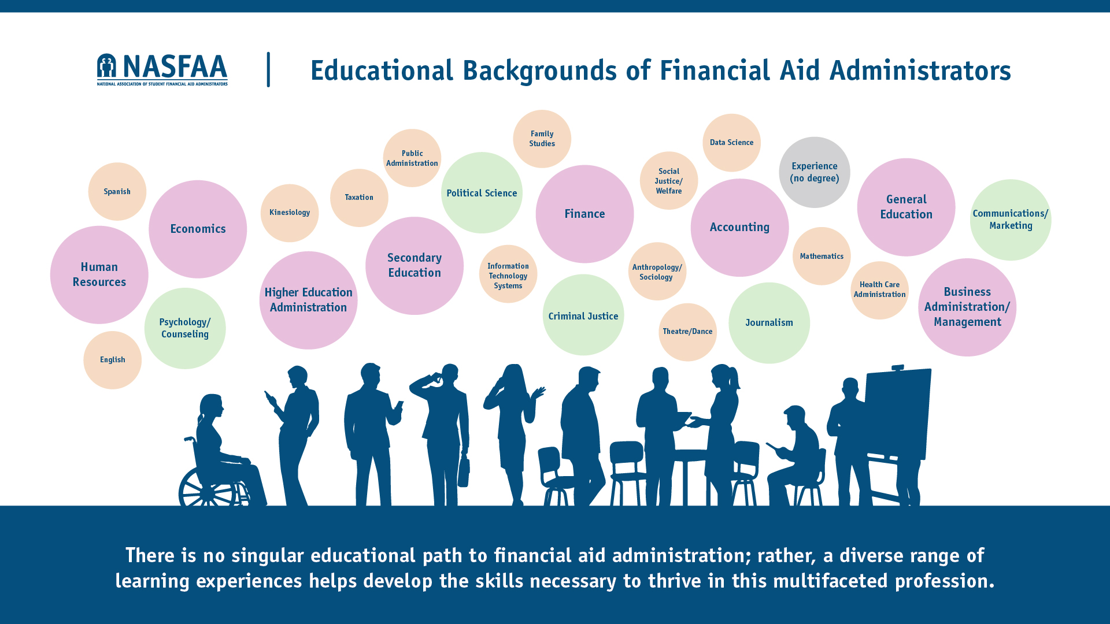
INSERT MAJORS GRAPHIC

Slide 7
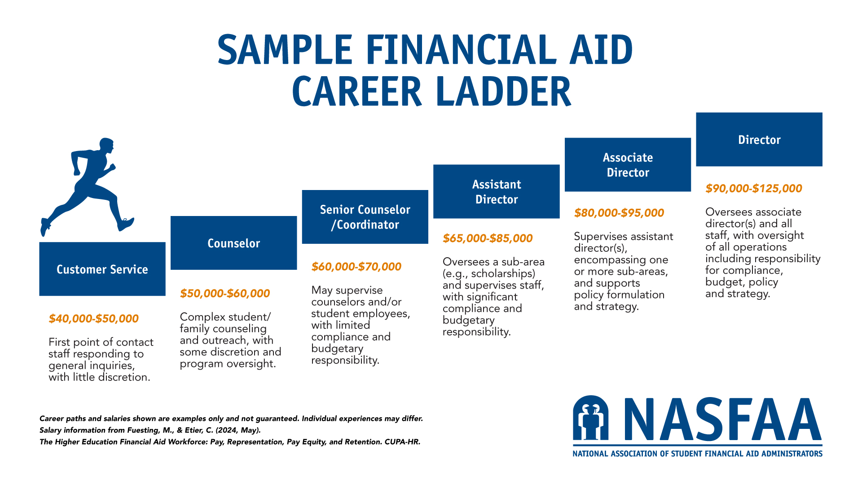

Slide 8
Meet the Faces of Financial Aid
We’ll spend some time getting to know current financial aid professionals! These stories showcase the wide range of backgrounds, responsibilities, and career trajectories within financial aid.
  Entry Level: Counselor, Advisor, Specialist
  Mid Level: Manager, Assistant/ Associate Director
  Executive Level: Director, Executive Director, AVP, VP

Slide 9
Insert Profiles
Profiles available at http://www.nasfaa.org/financial_aid_profiles

Slide 10
Where to Find Financial Aid Job Postings?
NASFAA’s Career Center
Chronicle Careers
HigherEd Jobs
Inside HigherEd Jobs
LinkedIn
Campus Job Boards
State and Regional Association

Slide 11
Interested in NASFAA Membership?
If you're a student interested in accessing NASFAA resources, ask your institution’s NASFAA Primary Contact to add you to the roster.
Once added, you’ll be able to create a NASFAA account and gain access to valuable member benefits like Today’s News.

Slide 12
Questions and Answers
Thank you for attending!

