Slide 1

<presenter name>
<title>
<office>
Notes:
Please note: we provide presenter instructions and notes in brackets < >
<These speaker’s notes are suggestions only. Feel free to customize this presentation to meet your speaking style, your needs and your audience. Throughout this presentation, we’ll use “financial aid office” but please change the references to the specific name of the office at your institution. It may be helpful to print out both pages of the “What financial aid administrators do” as a handout for the participants.>
<If you were not introduced by someone else, introduce yourself to the group. Include your title and how long you’ve been in the profession and/or at the school.>
<OPTIONAL ACTIVITY>
By a show of hands how many of you have heard of the financial aid office?
<comment on responses>
For those of you who have heard of us, what is one thing that we do?
<comment on responses…it may give you some insight into the level of knowledge of the group>
It sounds like you have some solid ideas of what we do in the financial aid office. Yes, we <reiterate some of the more popular or generic responses, such as “process loans” or “help students with FAFSAs”>, but we do even more. The point of this presentation is to teach you about the various areas that financial aid administrators help, students and families, the school, the community and our upper administration.
<click to next slide>

Slide 2

Notes:
As a financial aid administrator, my primary function is to help students achieve their educational potential by helping award and disburse monetary resources. But there’s more to what my colleagues and I do in the financial aid office.
<click 1 – blue quadrant appears>
First, and probably the most obvious, we serve students and families.
<click 2 – green quadrant appears>
But we also help our school.
<click 3 – pink quadrant appears>
We provide valuable resources for the community.
<click 4 – orange quadrant appears>
And we can help you and your offices. <customize for audience>
I’d like to take a few minutes to explore each of these in detail. You can follow along on your handout as well. Keep in mind these are just a sampling of what we do on a day-to-day basis.
<click to next slide>

Slide 3
Administer financial aid programs:
  Aid availability.
  Review qualifications.
  Equitable distribution.
  Requirements for future years.
Application processing:
  Help students file FAFSAs.
  Verify eligibility.
Provide financial literacy and debt management strategies.
Mitigate a student’s special circumstances.
Advocate for aid simplification.
XX% of students receive some form of student aid coordinated by the <office name>.
Notes:
<Regarding the blue box at the bottom of the screen: If you choose to provide information about your office/school, you will need to update this information. Otherwise, you may delete the box before the presentation.>
Let’s look first at some of the things we do to help our students.
<click 1 – first set of bullets appears>
Our primary function is to help students fund their educational programs by administering federal, state, local, institutional and private financial aid programs. That means we need to know what aid is available through these resources and the qualifications students must meet to receive the aid. We also need to make sure we distribute aid – especially federal funds – equitably to eligible students and help students understand how to keep their aid in future years as well.
<click 2 – second set of bullets appears>
Any student who wants to be considered for federal financial aid must file a Free Application for Federal Student Aid, or FAFSA. We spend time answering questions from students and families to help them fill out the application accurately every year. Once the application is complete, we need to make sure the student meets all the eligibility criteria to receive the funds. Sometimes a student gains or loses eligibility for funds throughout the year, so awarding a student’s aid is not always a “once and done” event; we may have to adjust a student’s aid package during the school year as well. Keep in mind that the FAFSA is only one piece of the puzzle – if the student wants to be considered for state, local or institutional aid, other applications and/or criteria may apply. <could take this opportunity to discuss any institutional aid applications (e.g. CSS Profile)>
<click 3 – next bullet appears>
Some students need extra help with their finances, which we provide through financial literacy discussions and helping students not borrow more than they need. <discuss any specific activities, courses, workshops, etc. that your office coordinates and/or conducts>
<click 4 – next bullet appears>
Some students have special circumstances that may hurt a student’s chances of success. For example, a family may have suffered a loss of income due to a job change or loss and cannot afford to pay for school any longer. We at the financial aid office may be able to help by changing the student’s FAFSA data to more accurately reflect the current financial situation. Another student may have a medical issue going on that caused him to withdraw or miss a significant period of classes. The federal government requires us to intervene when a student withdraws or is not making academic progress toward a degree or certificate.
<click 5 – next bullet appears>
We know that the aid process can be confusing for some students, so we advocate for simplicity whenever possible. We work with our various state, regional and national associations to promote policies that benefit students and reduce administrative burden on our offices, so we have more time to focus on counseling students.
<click 6 – blue box appears>
I’d like to point out that X percent of our students receive some form of financial aid that is coordinated through our office. That equates to XXX students that we assist with funding their educational expenses.
<click to next slide>

Slide 4
Enroll & retain students.
Manage receipt of funds to help students meet institutional costs.
Provide student employment opportunities.
Ensure compliance with laws and regulations:
  Federal.
  State.
  Local.
  Institutional.
Membership & participation in professional associations provide opportunities for advocacy and professional development.
The typical cost of attendance is $xx,xxx and the average amount of financial aid awarded to students is $xx,xxx.
Notes:
<Regarding the green box at the bottom of the screen: If you choose to provide information about your office/school, you will need to update this information. Otherwise, you may delete the box before the presentation.>
In addition to helping students and families, we also provide valuable resources to the school.
<click 1 – first bullet appears>
We help with enrollment management goals because many students would not enroll or stay without adequate financial support. <Could discuss any relevant enrollment management reporting structure here that applies to the office or how your office helped meet enrollment management goals.>
<click 2 – next bullet appears>
Nationwide, the government provides approximately $150 billion in grants, work-study and loans every year, and our school gets a portion of those funds. So we have to manage this pool of money, along with all the other scholarships, grants and loans from non-federal sources, to ensure students have the funding to attend school.
<click 3 – next bullet appears>
<If your office does not coordinate employment on campus, refer the audience to the appropriate office>
The financial aid office also provides employment opportunities for students on-campus. <OPTIONAL ACTIVITY: Ask the audience if any of them worked on campus while they were in college; ask what office/job; comment on responses, including your own experience, if relevant> These jobs benefit the students by helping them stay out of debt providing funds to help them pay for living and school expenses, as well as provide them an opportunity to gain valuable work experience. These jobs also help the school fulfill necessary functions. <OPTIONAL ACTIVITY: How many of you have student employees in your offices? What kinds of jobs do they perform? How do they change your office environment? How would your office function differently without them?>
<click 4 – next bullet appears>
The financial aid office has thousands upon thousands of pages of rules and regulations to comply with when administering financial aid programs. However, not all of those rules fall under our area of expertise. For example, there are rules that require disclosure to students the statistics of fires that occur on campus, details about the athletic coaching staff, and the number of campus safety incidents. Our office assists with ensuring these requirements are met, but really the compliance of rules and regulations applies to the entire school. And we’re here to help make sure our school remains eligible for financial for many years to come.
<click 5 – next bullet appears>
One of the ways we stay abreast of changes, receive clarification about rules and regulations, and have the opportunity to advocate on behalf of students and our school is through our membership in professional associations. For example, the National Association of Student Financial Aid Administrators has a dedicated staff to monitor legislative and regulatory changes, provide training and regulatory assistance, conferences to network and connect with other aid administrators, and opportunities to meet with Congressional staffers to advocate for financial aid policy changes.
<click 6 – green box appears>
The average COA for our <undergraduate, graduate, all> students is $XX,XXX and the average amount of aid we award to the same group is $XX,XXX, or XX% of the total COA.
<click for next slide>

Slide 5
Provide student employees:
  Community service activities.
  Math and/or literacy tutors.
  Local businesses.
Serve as a resource for:
  High school counselors.
  Community-based college access programs.
Educate the community:
  Budgeting.
  Financial literacy.
  Financing an education beyond high school.
<your school> has XX off-campus Federal Work Study placements.
Notes:
<Regarding the pink box at the bottom of the screen: If you choose to provide information about your office/school, you will need to update this information. Otherwise, you may delete the box before the presentation.>
Our next quadrant discusses how financial aid administrators help the community.
<click 1 – first set of bullets appears>
<Amend or remove if your school does not participate in Federal Work-Study>
As you might know, our school participate in the Federal Work-Study program, which allows students to earn money to pay for school expenses. The federal government provides a portion of the student’s wages, and the remainder comes from the school or another non-federal source. One of the requirements to participate in FWS is that a portion of the funding must be used for students to perform jobs that serve the community, including being math and/or reading tutors for children and adults. Even for-profit agencies in our community may be able to benefit from FWS students, as the government will provide part of the wages and the company covers the rest.
<Note: the pink box appears next since it deals with FWS statistics>
<click 2 – pink box appears>
Our school offers XX opportunities for students to earn FWS funds while working off campus in either community service or within for-profit companies.
<click 3 – second set of bullets appears>
We work to maintain a positive relationship with our local high school counselors and other college access programs in our community. We’re often seen as a trusted resource and are approached regularly to help answer questions or assist students with navigating the financial aid process.
<click 4 – third set of bullets appears> <Note the last sentence asks for your own data; amend or remove as necessary>
Our office also serves as an educator to teach not only our school’s students, but also secondary and elementary students about budgeting and financial literacy. We conducted <x> events last year off campus to help future students learn how to fund their postsecondary educational goals.
<click to next slide>

Slide 6
Provide statistics:
  Aid applications & recipients.
  Funding increases & decreases.
Justify institutional budget requests using data regarding costs and federal aid received.
Contribute information for public relations and the recruitment of students and staff.
Advocate for adequate funding and reasonable eligibility criteria.
Alert school administration about proposed legislation that would affect the school or students.
Contact the <your office name> at <name, phone, email>.
Notes:
<Regarding the orange box at the bottom of the screen: If you choose to provide information about your office/school, you will need to update this information. Otherwise, you may delete the box before the presentation.>
Finally, what can the financial aid office do for you? We can help you with a number of the activities we already provide to students, school and the community. For example, we’re happy to present a session on loan repayment, financial literacy or debt management for your students or staff members. Or, maybe you have questions about what happens to a student’s financial aid when he or she withdraws or drops classes? We can help with these things, and here are some others that may directly pertain to you.
<click 1 – first set of bullets appears>
If you’re working on a report (or just curious) about how many students apply for or receive aid, we have that data at our fingertips. Funding increases and decreases happen, and those changes can affect our enrollment and retention goals, so let us know if you want some statistics or insights about those figures as well.
<click 2 – next bullet appears>
Members of our upper administration may need to use these student and funding statistics to justify various office or whole-school budget requests to our <state, school governing board, board of trustees, etc.>.
<click 3 – next bullet appears>
We can help provide data or information if you are involved with public or community relations or recruit students to attend or staff to work at our school.
<click 4 – next bullet appears>
I know I’ve mentioned this a few times, but advocacy is a central part of what we do as financial aid administrators, but it’s something the entire campus can be involved in. When funding decreases happen, it affects how many students can enroll at our school. And when eligibility criteria and related regulations become overly complex and burdensome, it affects the services we can provide to those our potential, current and past students. Let’s work together to develop an advocacy plan that will benefit both students and the school.
<click 5 – next bullet appears>
We also must stay updated on potential policy changes that can both positively and negatively affect students. For example, for the 2017-18 year, the FAFSA (and CSS Profile) will start using what’s called “prior prior year” data. This is a huge benefit for students, as they will be able to more easily complete their financial aid applications. However, the implementation of this change will be a challenge at first. We <need to/already have> discussed with you some of the potential ramifications at our school, just as we will with any significant policy changes in the future.
<click 6 – orange box appears>
If you have any questions or ideas for how the financial aid office can serve you and your students, please don’t hesitate to contact us.
<click to next slide>

Slide 7

Notes:
Before we wrap up, I’d like to briefly discuss some of the ways we interface with the other offices at our school.
<click to next slide>

Slide 8
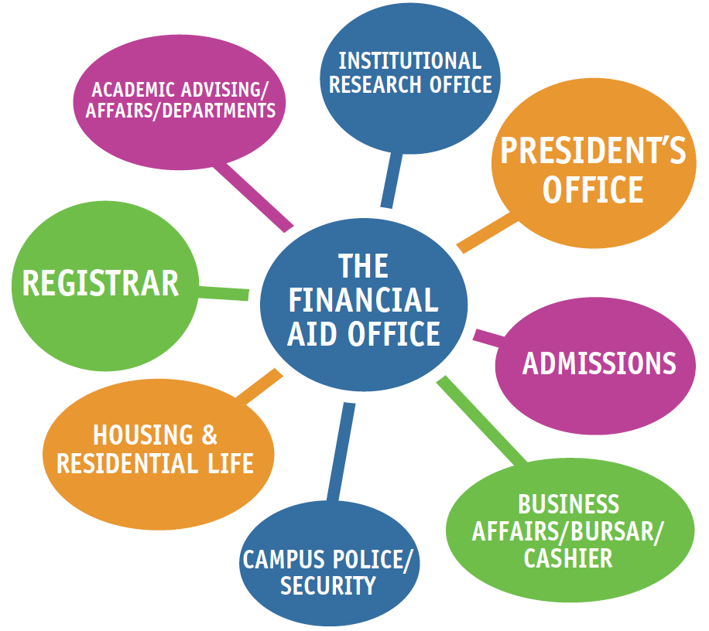
Notes:
<This can be an opportunity for interaction with your group. Discuss with and/or ask the audience about any interactions they’ve personally had with your office (inflows and outflows). Highlight some of the items provided on the handout already. What other areas might be opportunities for collaboration? Are there other offices that we may need to have relationships with on campus?>

Slide 9
Notes:
<Feel free to add blank slides throughout the presentation or at the end to customize your message>

